Slide 1
Recipe for Disaster!
By:
Andrew Bankston
Jacob Zacarias
Jonathan Hicks
Walaa Alani

Slide 2
About the Project
This program is designed to retrieve data from the website allrecipes.com, and transform the retrieved data before loading it into a local database in MongoDB; keeping the database updated regularly and on a monthly basis.
We used the ETL process to implement this project .

Slide 3
EXTRACT
TRANSFORM
LOAD
STEPS

Slide 4
Tools Used
Extract Data
Scraping website: ‘allrecipes.com’
Data formatted (html)
Transform Data
Jupyter NoteBook
Cleaning
Filtering
Load Data
Non-relational final database
Final six collections - one for each category
BeautifulSoup • MongoDB

Slide 5
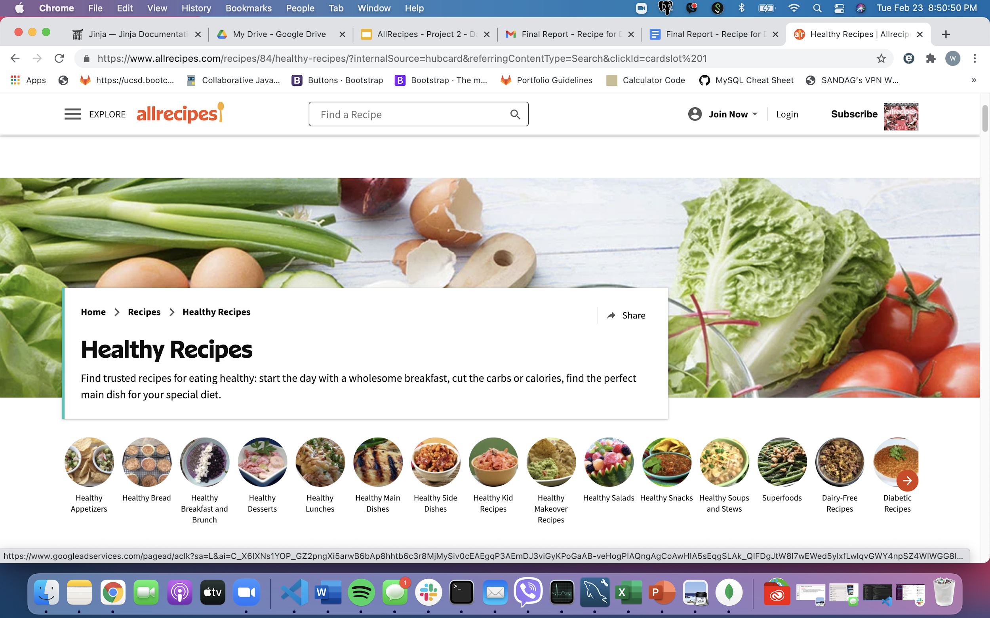
Notes:
Example of scraping the allrecipes.com - choosing healthy recipes [go to next page]

Slide 6
Categories
The categories we focused on are:
Healthy Snack Recipes
Low-Calorie Recipes
Low-Carb Recipes
Low-Cholesterol Recipes
Low-Fat Recipes
Weight-Loss Recipes

Slide 7
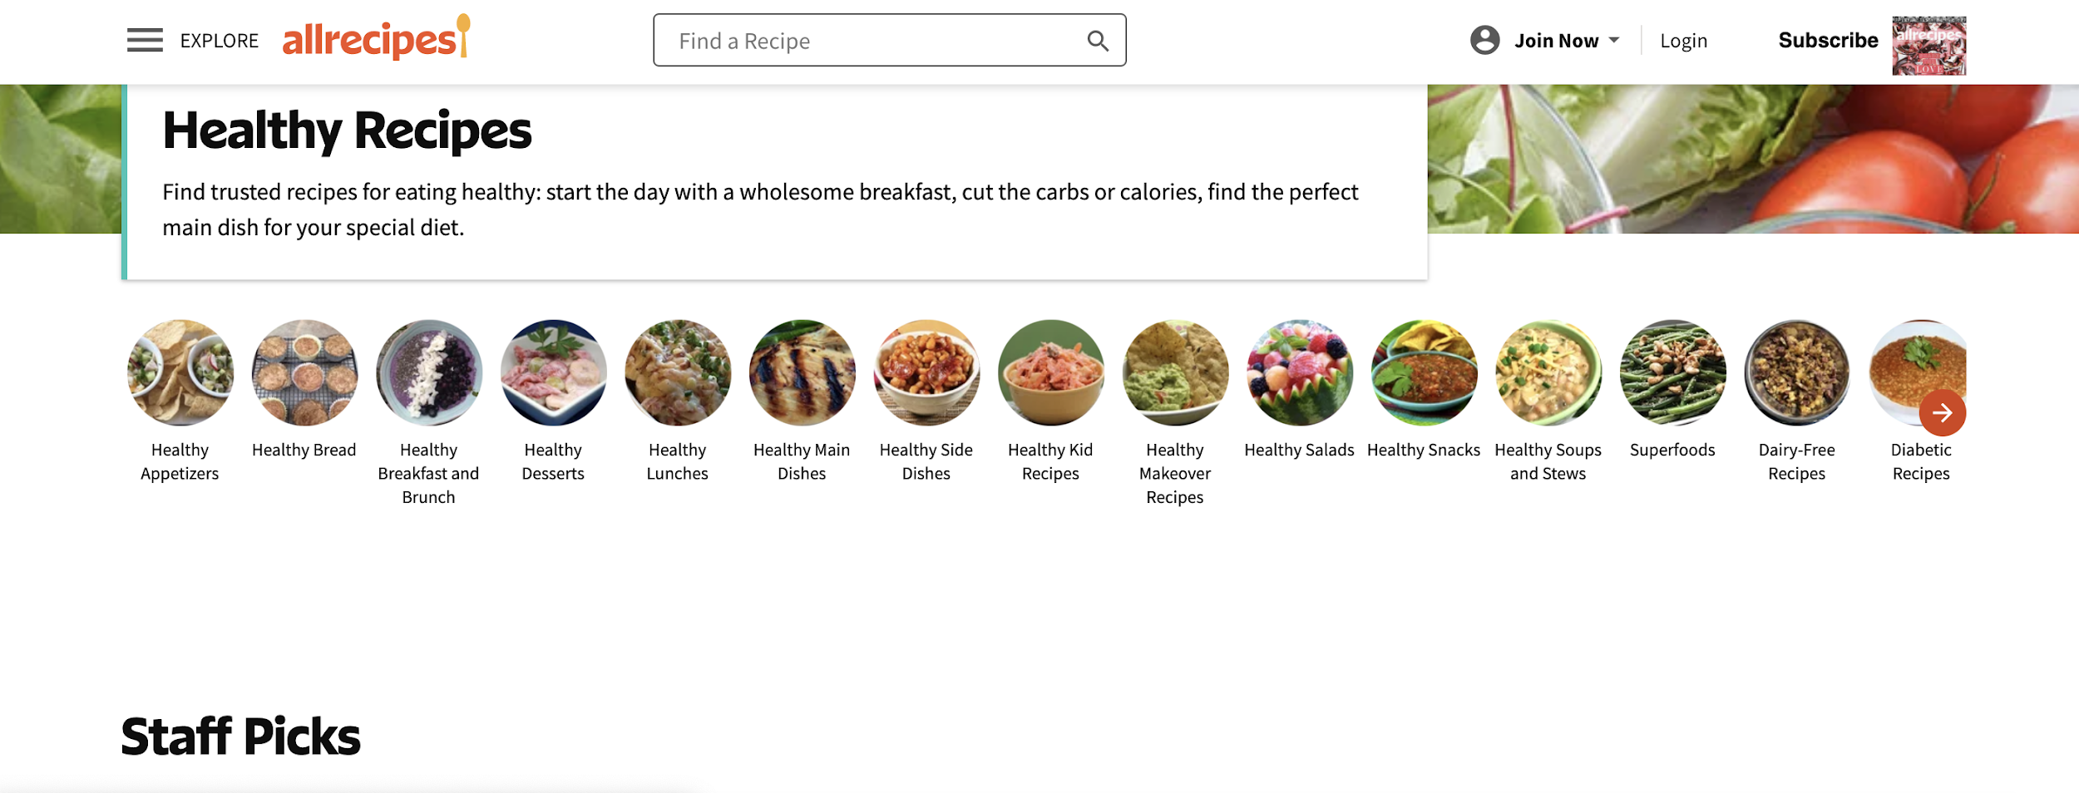
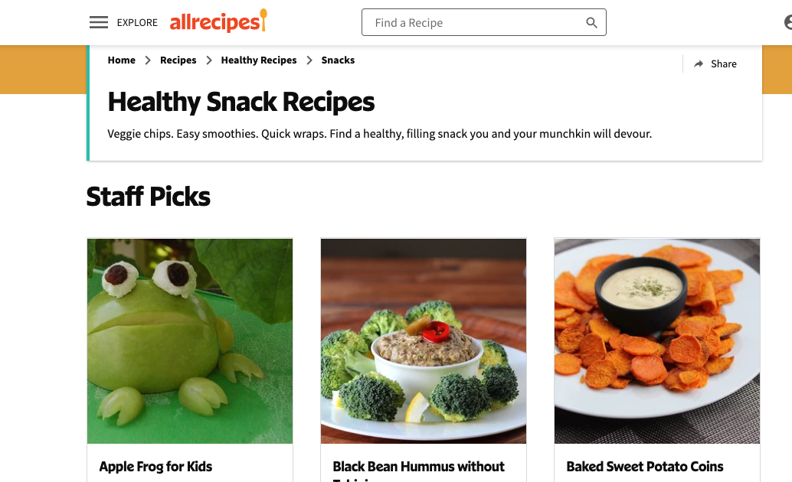
Notes:
Clicking on Healthy Snack [go to next page]

Slide 8
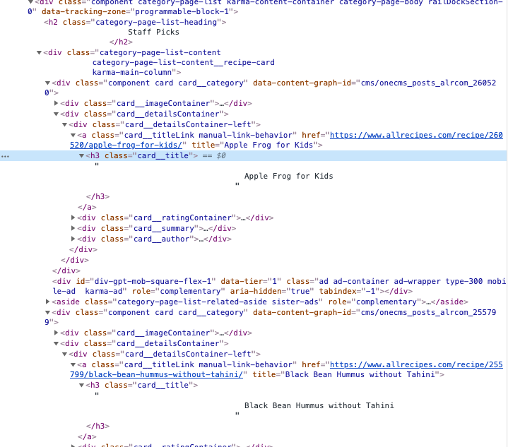
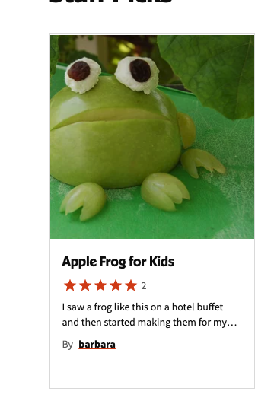
Notes:
Right click on the recipe and click on inspect to show the tags related to the info we need to scrape for the purpose of our project [title, rating, ingredients, nutritions]

Slide 9
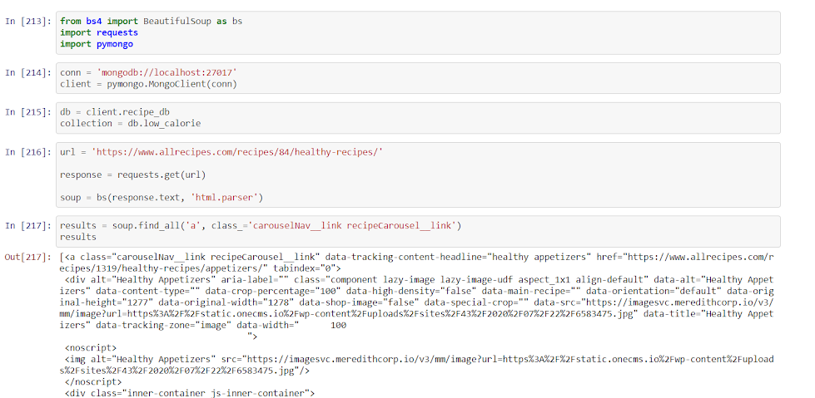
Establishing a connection

Slide 10
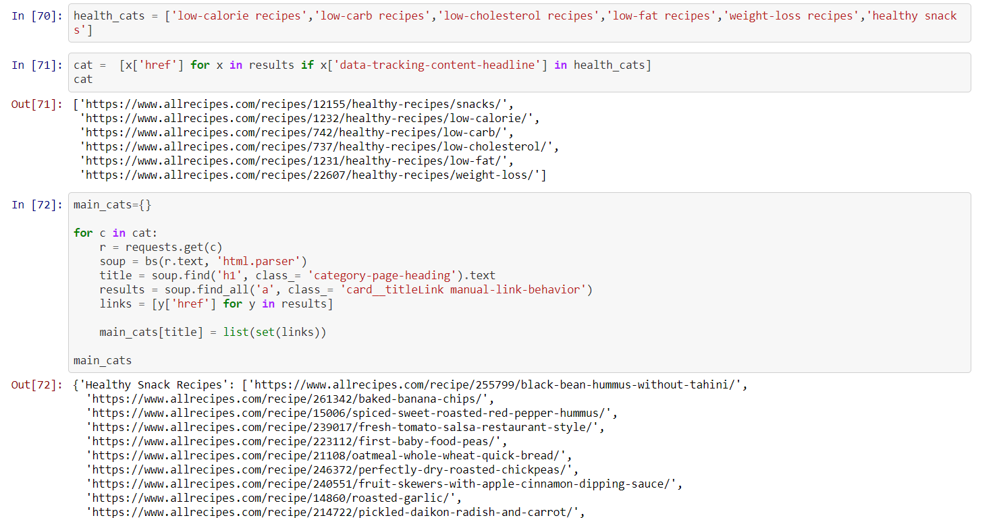
Scraping the Data for each Category - Extract

Slide 11
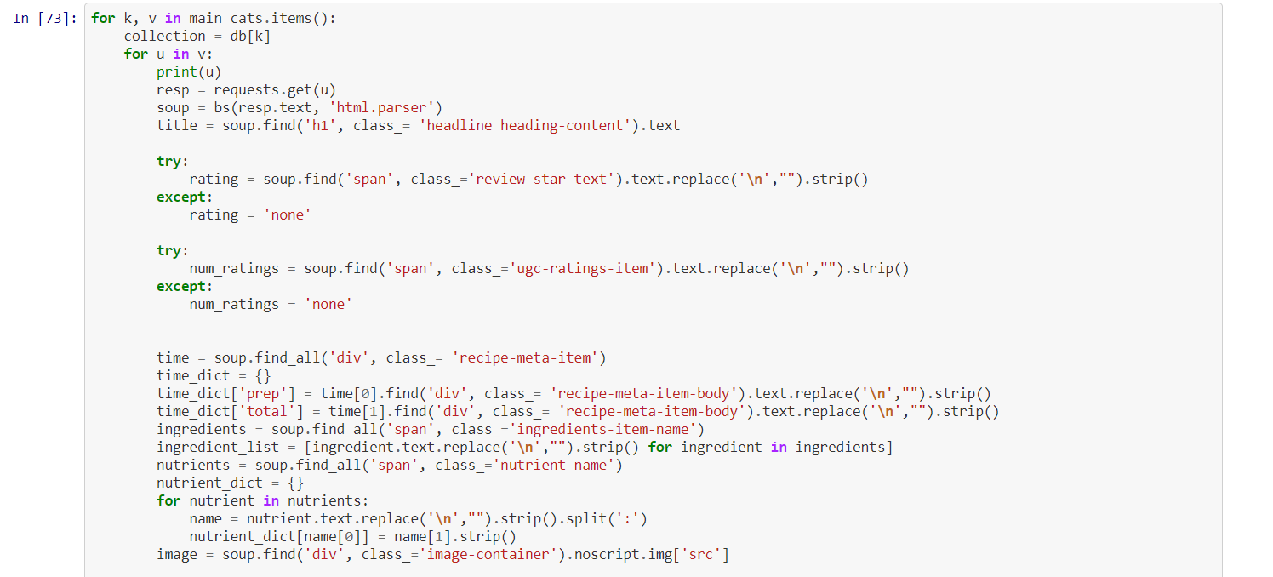
Deriving Information From Each Recipe - Transform

Slide 12
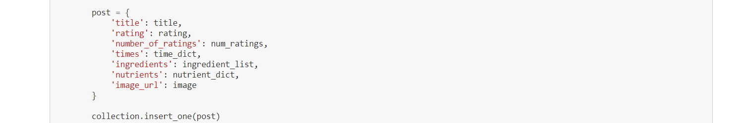
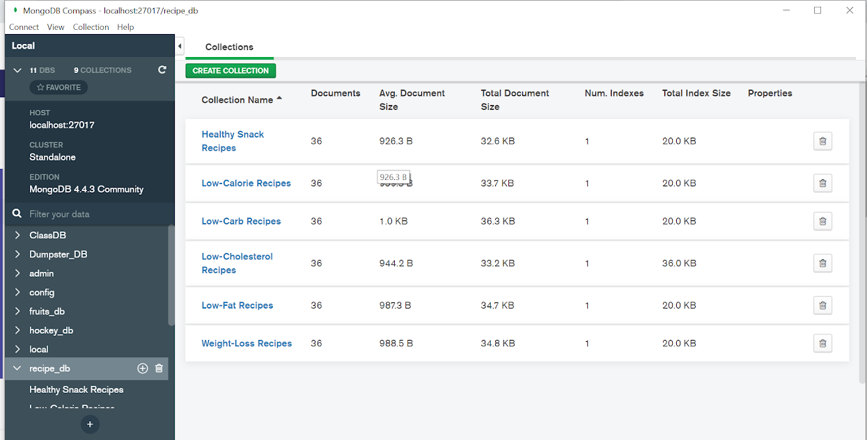
Saving Data in Categories - Load

Slide 13
MongoDB
After getting all of the information for each recipe for all of the categories, we were able to assign the data into six collections in MongoDB.
Using the collection.insert_one method at the end of the for loop, the ‘post’ dictionary which holds all of the recipe information was dumped into a collection for each category.

Slide 14
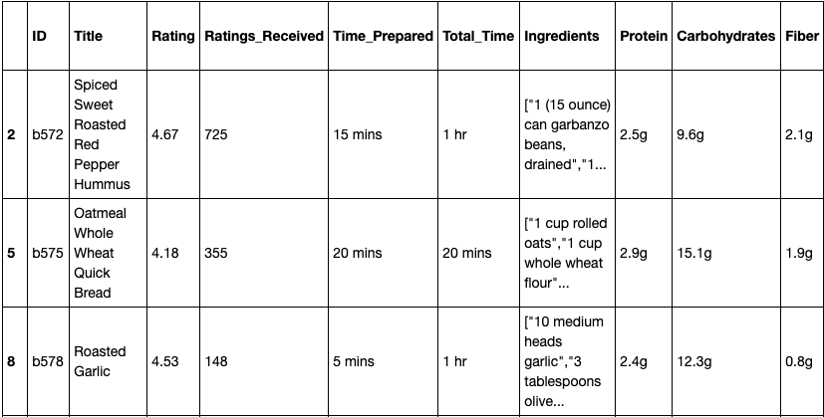
Summary
We took the approach to gather healthy recipes for people who want to make the transition to healthy eating, The collections in MongoDB can be filtered to align with certain conditions people may want, such as:
High protein recipe
Highest nutritional value
Highest rated recipe
Most reviewed recipe
Filter for allergies
Least amount of ingredients needed

Slide 15

Questions?
All files and final report available at:
https://github.com/jonhicks123/ETL-Project

